Slide 1
Introduction to Reinforcement Learning

Slide 2



BIG PLAYERS IN RL

Slide 3
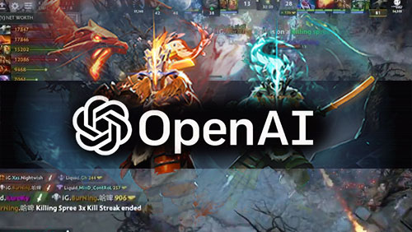
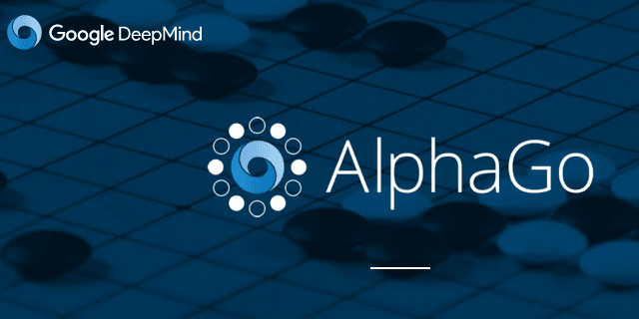

BIG PLAYERS IN RL

Slide 4
340 million shares 11 Billion Notional
Whoa! That’s a big number, aren’t you proud?

Slide 5
Agenda
Introduction
AI, ML, DL, RL and Big Data
Introduction to RL
How does RL work ?
AI Challenge

Slide 6
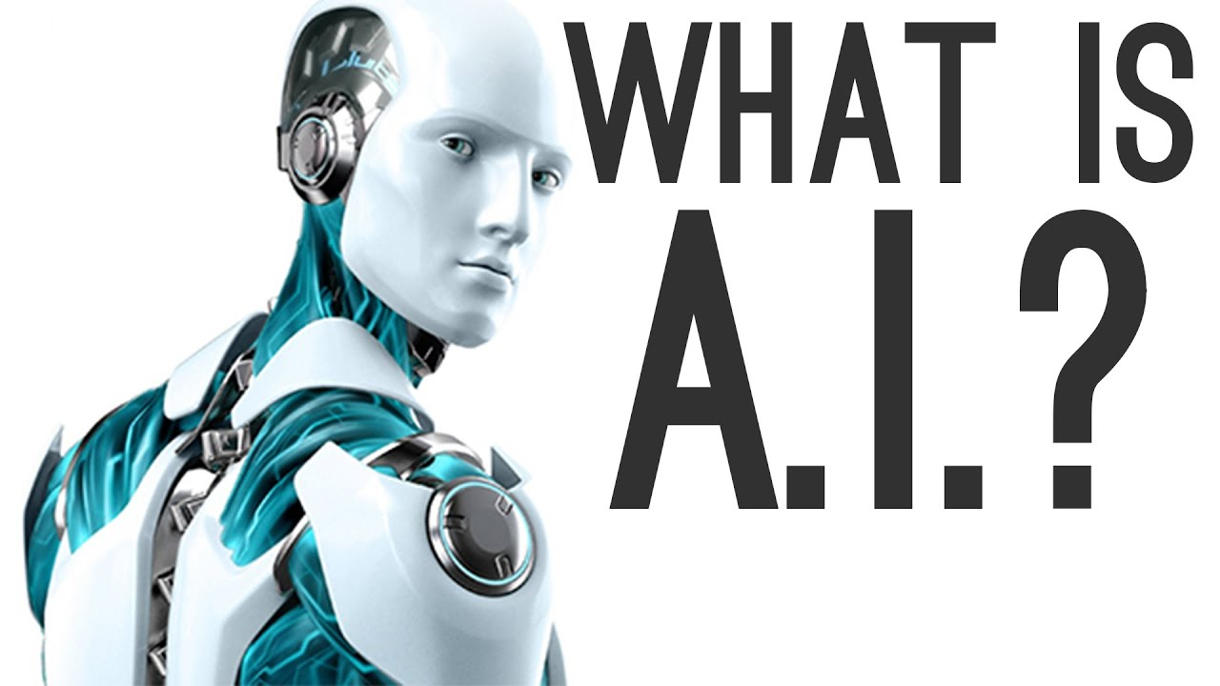
Introduction
Intelligence demonstrated
by machines

Slide 7

Introduction

Slide 8
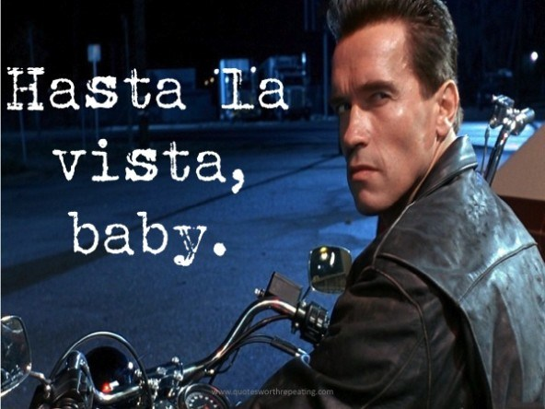
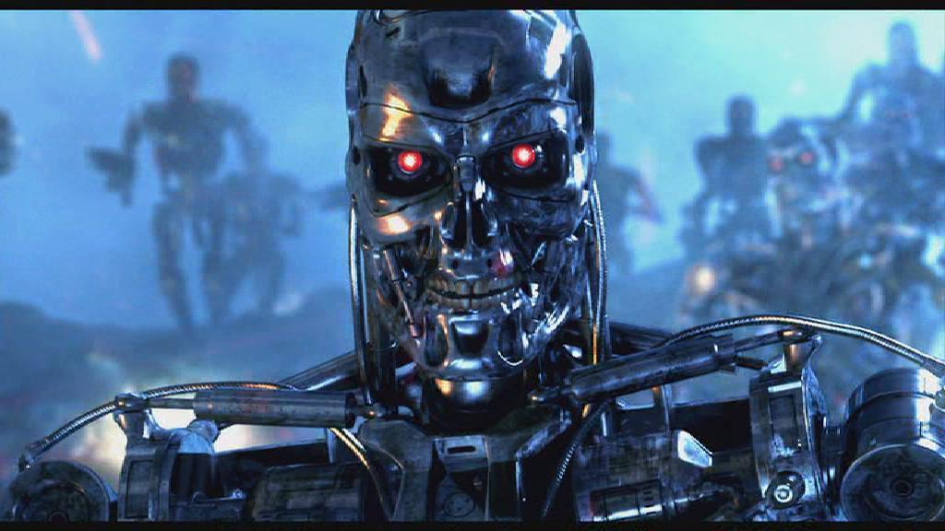
Introduction

Slide 9
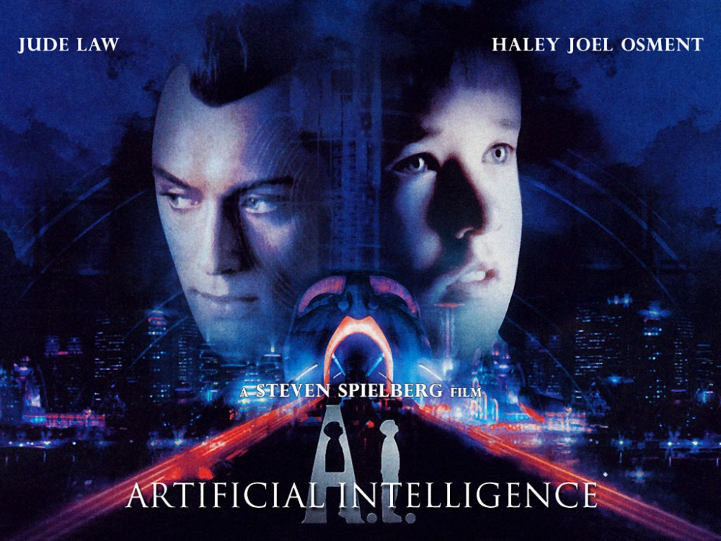
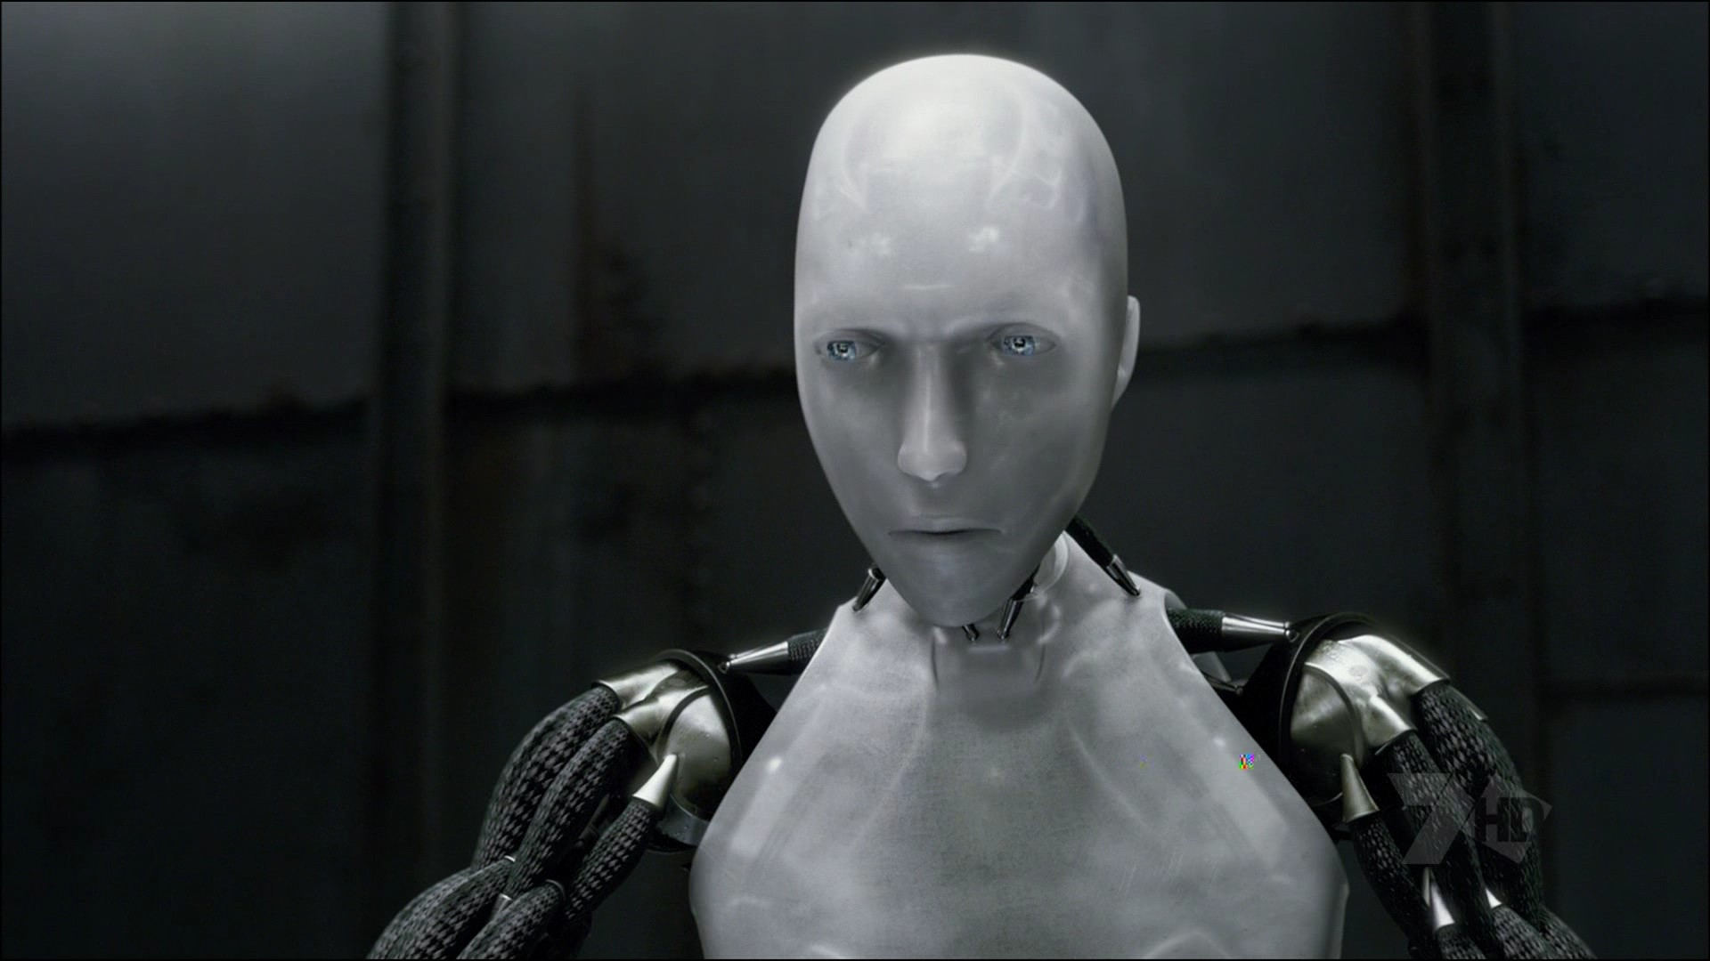
Introduction

Slide 10
What about AI in real life ?
Lets guess a few examples

Slide 11
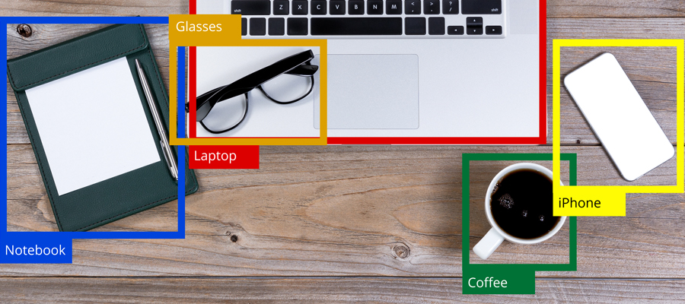
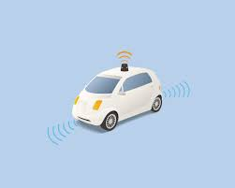
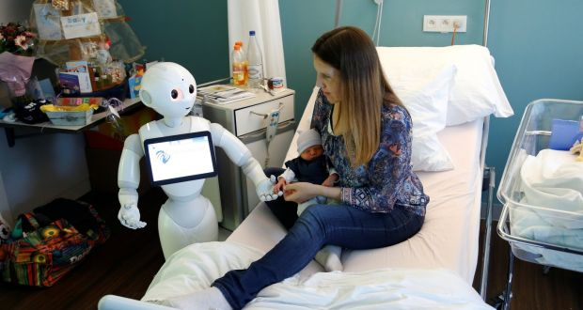

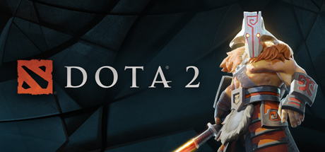
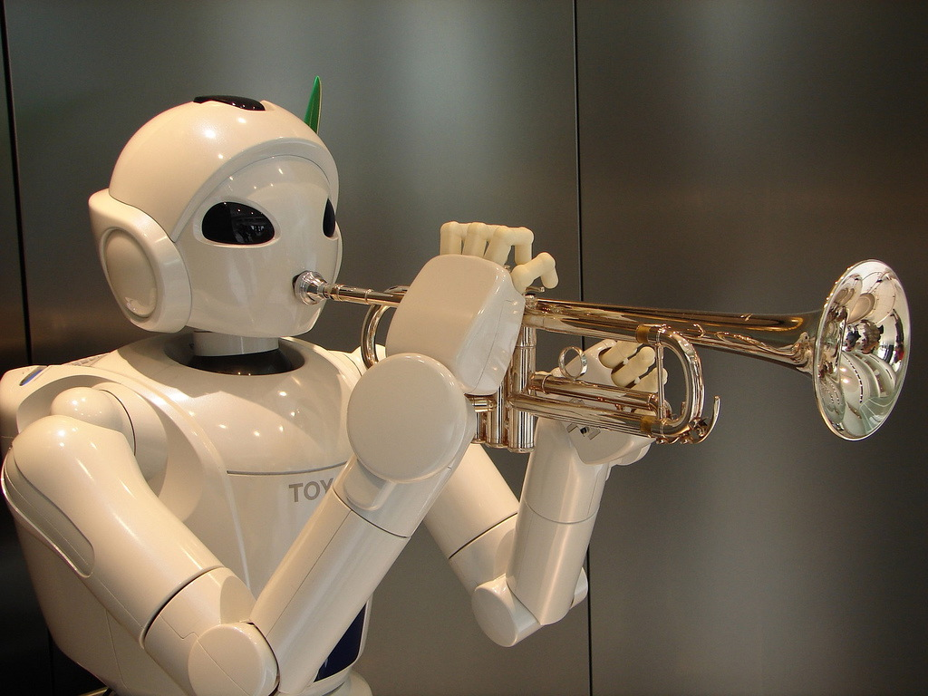




Slide 12
AI, ML, DL, RL, and Big Data

Slide 13
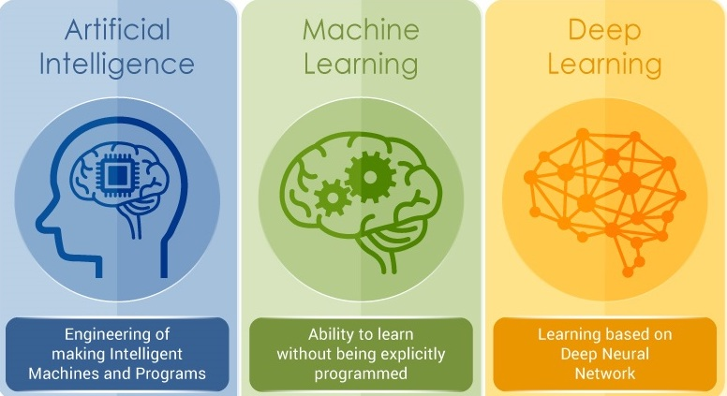
AI, ML, DL, RL and Big Data

Slide 14
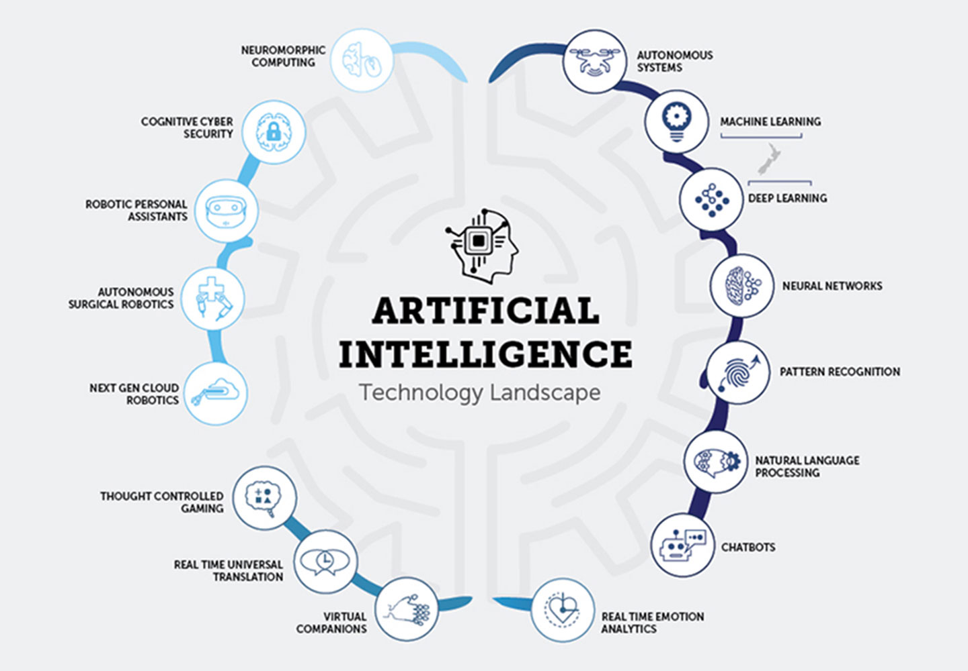
WHAT
IS
ARTIFICIAL
INTELLIGENCE ?

Slide 15
AI, ML, DL, RL and Big Data

Slide 16
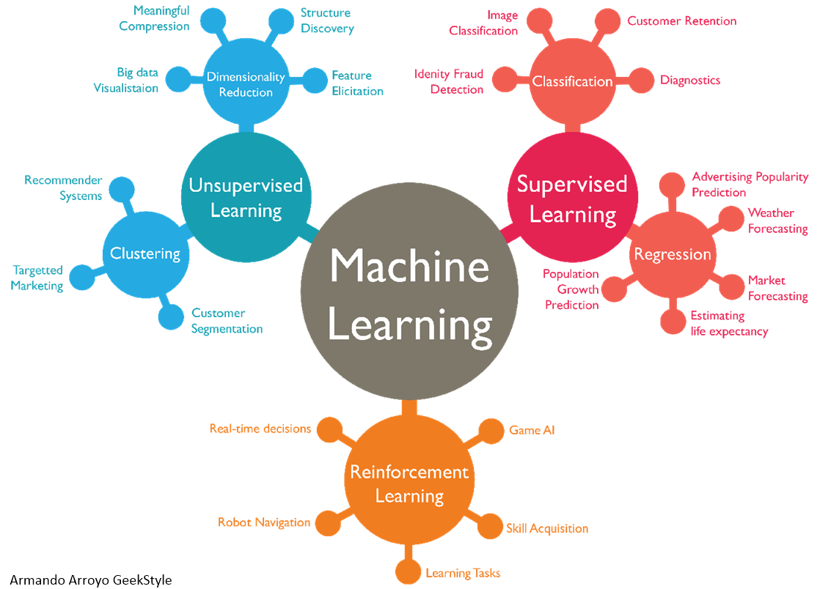





Slide 17
AI, ML, DL, RL and Big Data

Slide 18


Slide 19
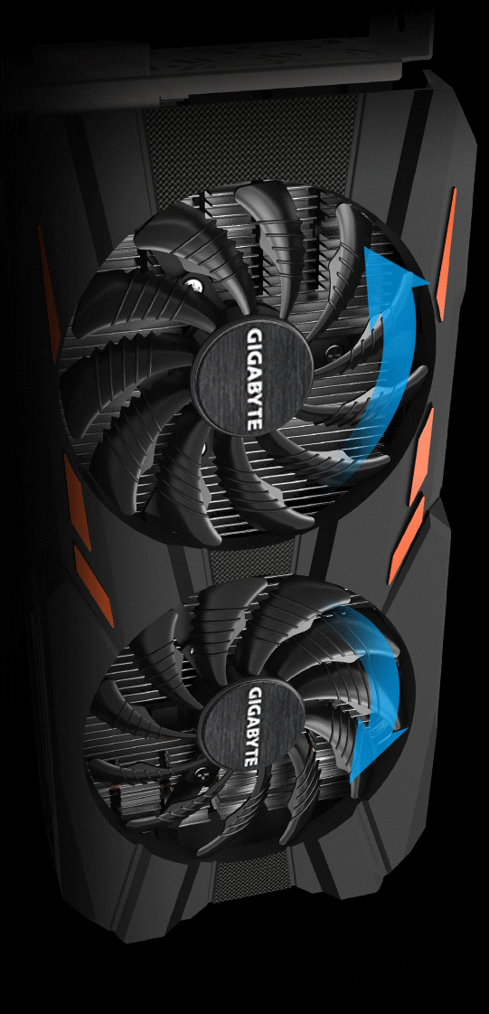

Slide 20

Agenda
Introduction
AI, ML, DL, RL and Big Data
Introduction to RL
How does RL work ?
AI Challenge

Slide 21
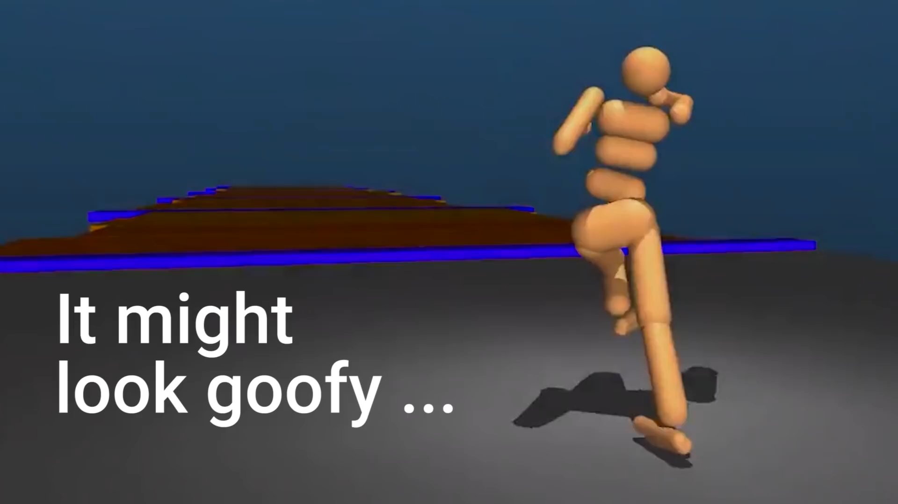
Humanoid learn to walk using RL

Slide 22
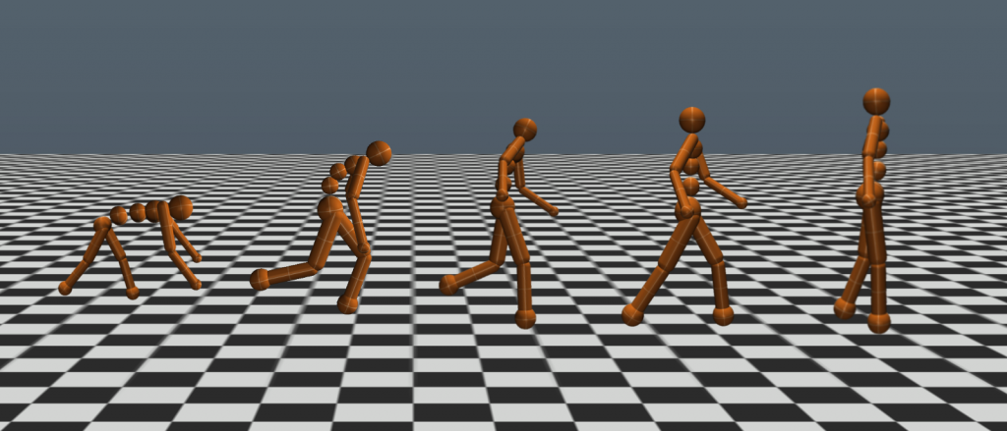
It all started with baby steps

Slide 23
HOW REINFORCEMENT LEARNING WORKS ?

Slide 24
Reinforcement Learning is nothing but learning from mistakes

Slide 25


Slide 26
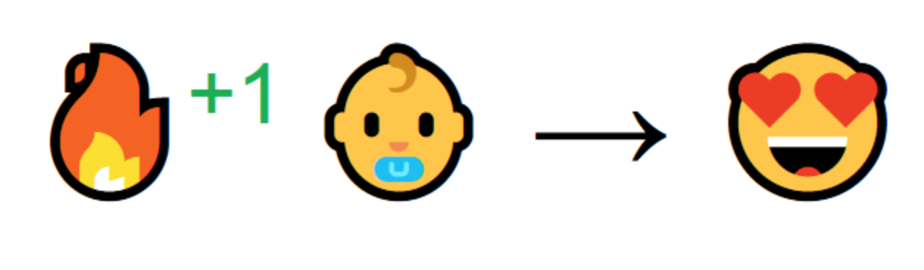

Slide 27
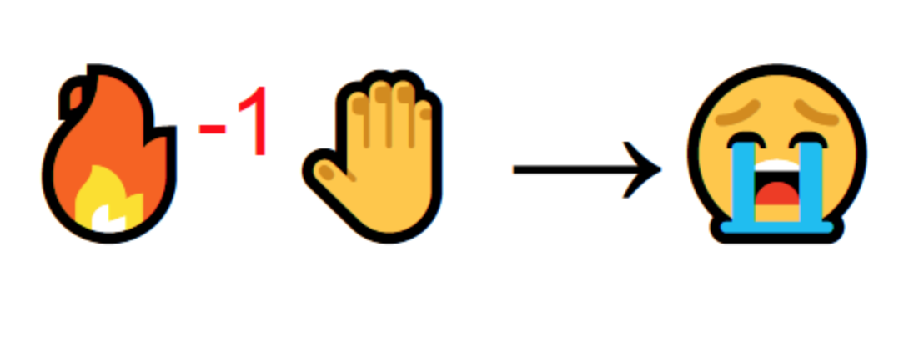

Slide 28
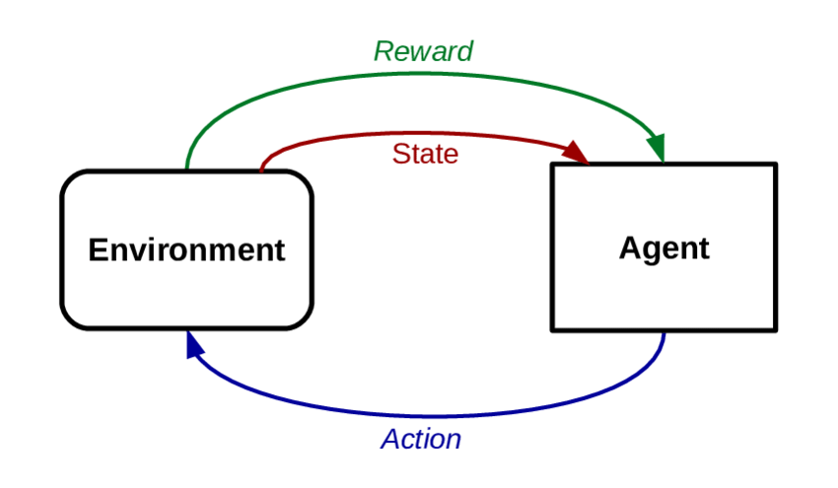
Introduction to Reinforcement Learning

Slide 29
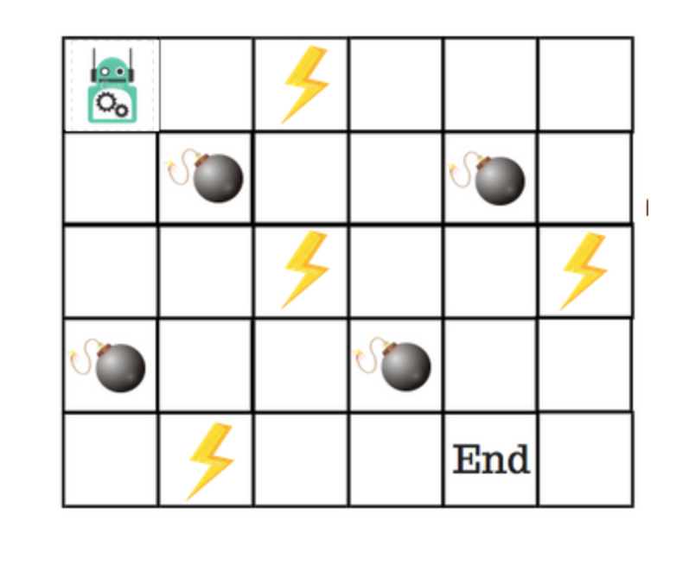
Q Learning
Goal : To reach the ”END”
Bomb: “GAME OVER”
Power up : ADDS one to life

Slide 30
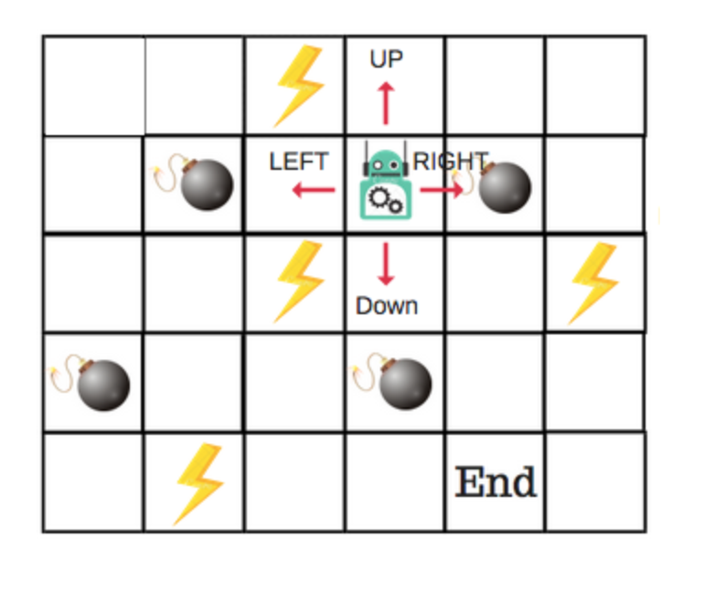
Q Learning
4 Actions
RULES:
START WITH 8 POINTS
LOSE A POINT EVERY STEP
BOMB: -100 POINTS
POWER: +1 POINT
END : +100 POINTS

Slide 31
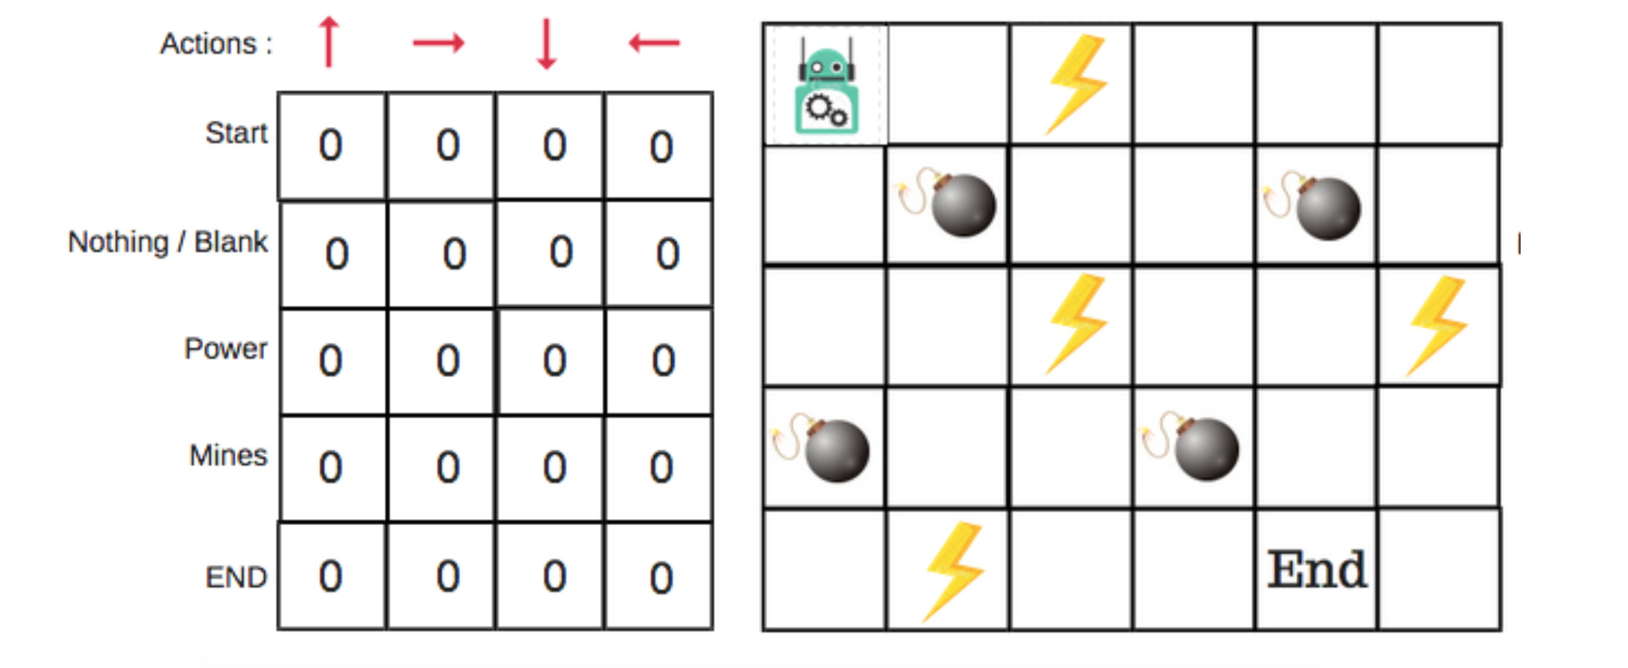

Slide 32
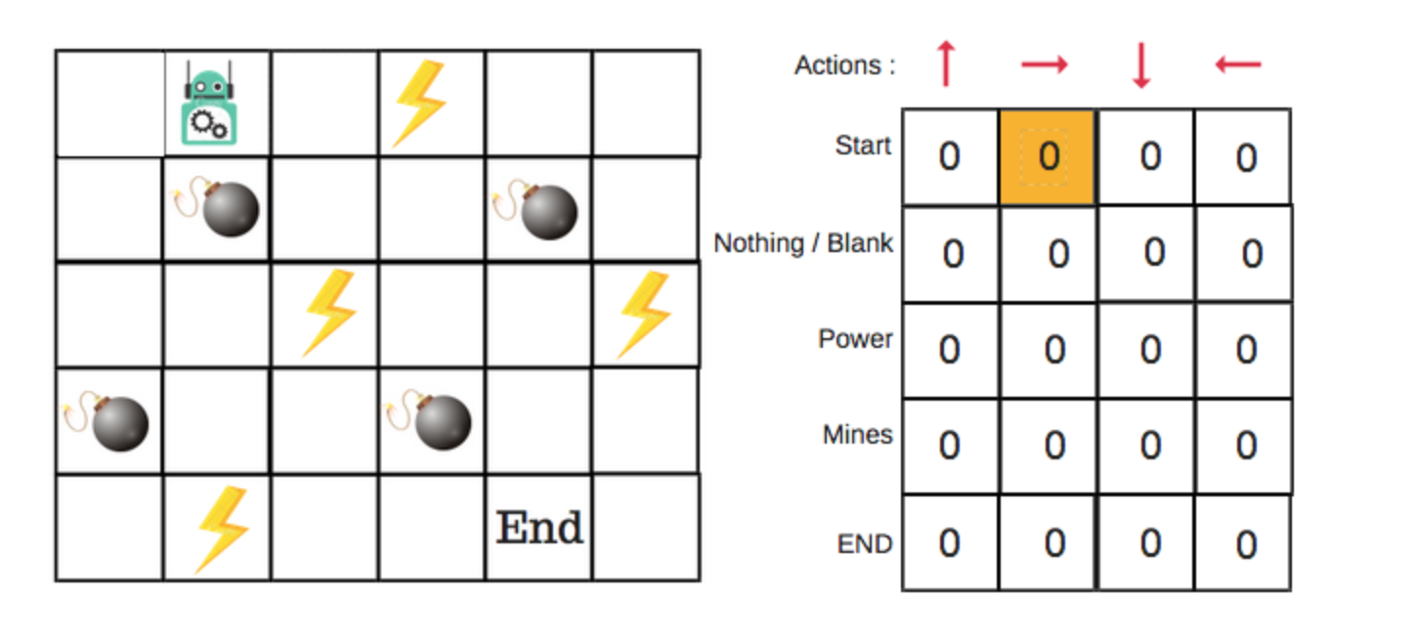
0.1

Slide 33

Bellman equation
Whoa! That’s bit complicated

Slide 34
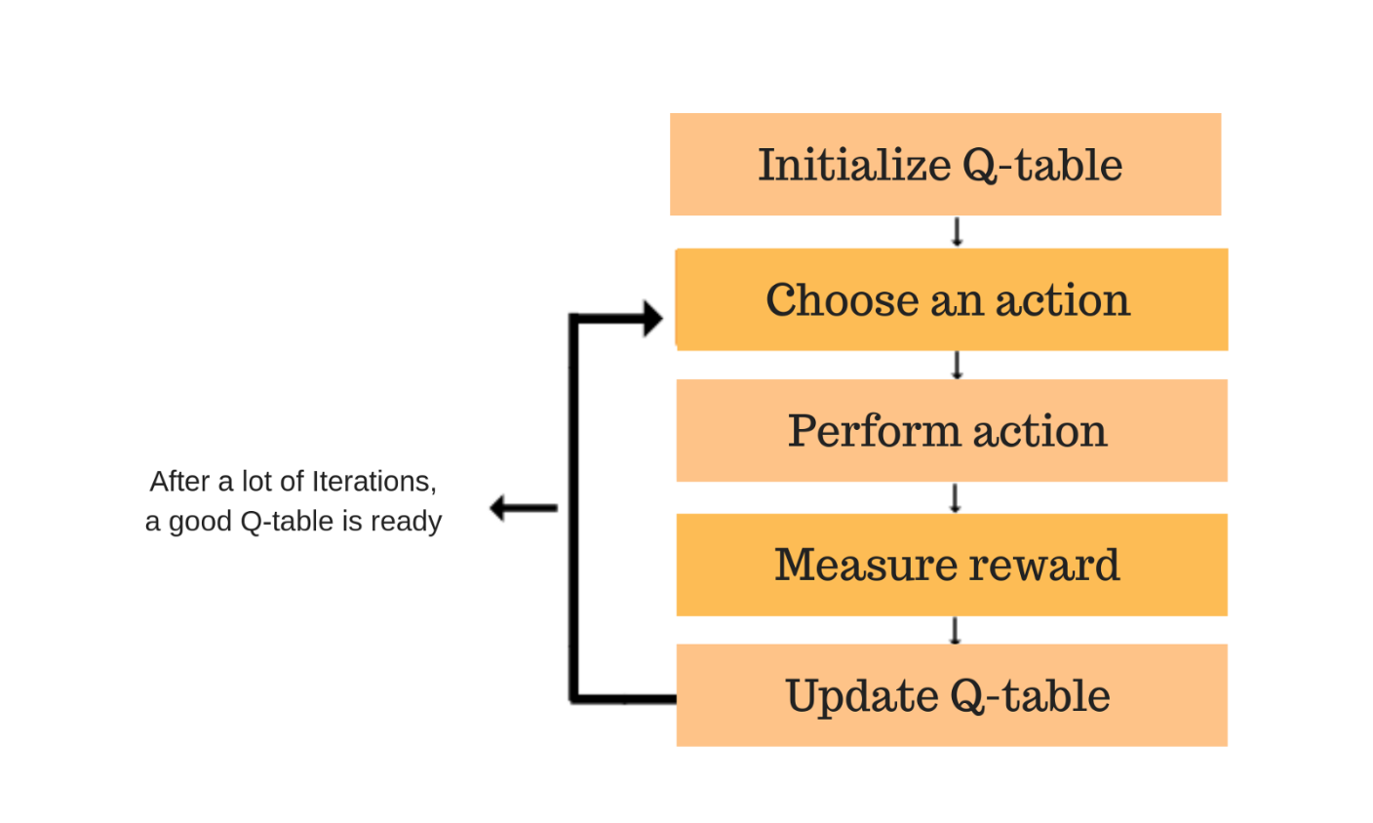
Q ALGORITHM

Slide 35
SO MANY ALGORITHMS OUT THERE
Q LEARNING
DOUBLE Q LEARNING
ADVANTAGE ACTOR CRITIC
RAINBOW RL
CURIOUSITY DRIVEN RL

Slide 36
Agenda
Introduction
AI, ML, DL, RL and Big Data
Introduction to RL
How does RL work ?
AI Challenge

Slide 37

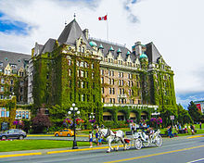
BATTLE SNAKE
AI CHALLENGE
March 2019, Victoria BC

Slide 38

BATTLE SNAKE AI CHALLENGE

Slide 39

CHOOSE YOUR ALGO
CHALLENGE
BUILD AN AI SNAKE USING ANY ALGORITHM
Min-Max
A* Search
Genetic Algorithm
Reinforcement Learning
Bread-First
Depth First
Beam Search
Evolutionary Algo
NO DATA
SCIENCE
NEEDED

Slide 40

THANKS!
Any questions?

Slide 41


I DO NOT OWN COPY RIGHT FOR ANY OF THE IMAGES ON THIS PRESENTATION.
ALL COPY RIGHTS BELONG TO PEOPLE WHO CREATED IT AND UPLOADED TO
THE INTERNET. SO PLEASE DON’T REPORT ME.

Slide 42
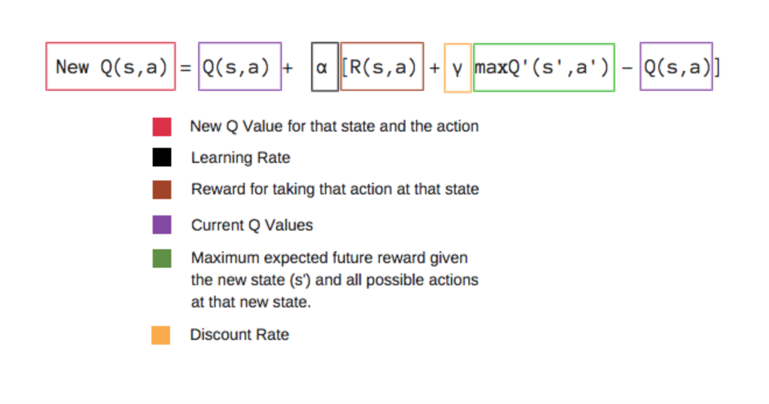
Bellman equation

